Slide 1

PREPARED BY: HURLEY EVANGELISTA | EMMANUEL DEVERA|
ALYSSA FERNANDEZ | MIGUEL MATAWARAN
Notes:
Good Afternoon po Sir and Miss. I am Alyssa Fernandez and these are my groupmates, Hurley, Emmanuel, and Miguel and we’re Team Dash-R-Come.

Slide 2


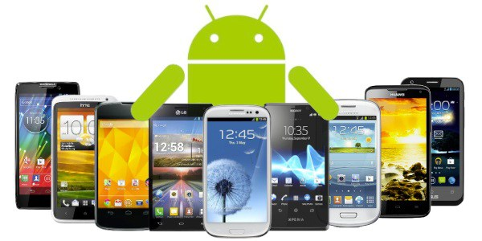





Notes:
Alyssa? Dash-R-Come is an Incident Reporter System that runs in Android devices and aims to help the Users to generate an Incident Report using the applications features and the Agency to get a detailed report for them to be able to respond to the User. As well as, for the both parties to have an evidence, statistics to future use. Project Scope are the places in Makati City and target Agency is Barangay Magallanes.

Slide 3
Objectives
To expand the scope of Pilipinas 911 services in terms of receiving incident reports.
To provide the client real-time and detailed incident reports.
To provide the client records of incident that occurs monthly.
To provide evidence or supporting details when reporting an incident to the client.
To provide evidence that can help the user in future use. (e.g. Dishonesty of the latter to the his/her fault)

Slide 4
Scope and Limitations
Motorists, bystanders, constituents and android device users
Mobile Data / Wi-Fi Connection

Slide 5
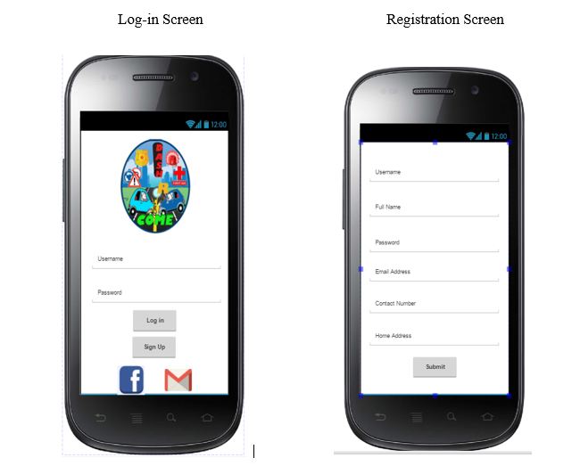
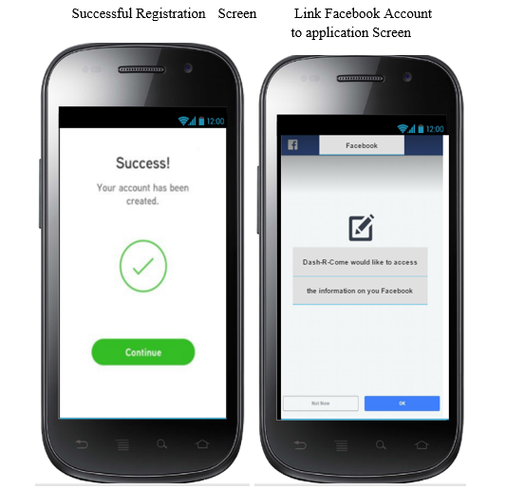

Slide 6
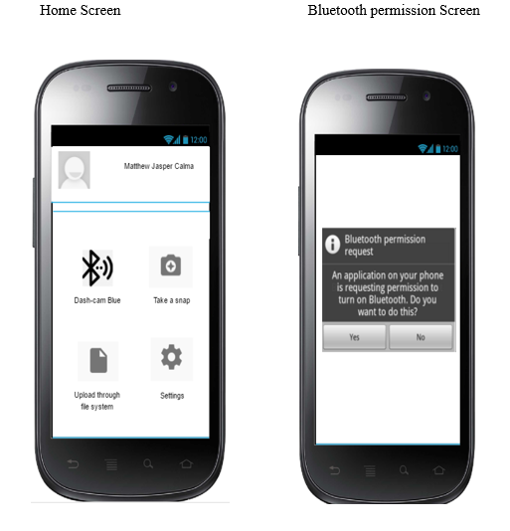
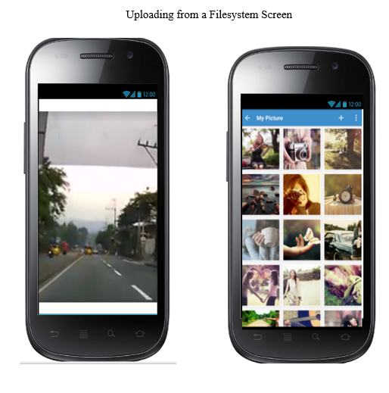

Slide 7
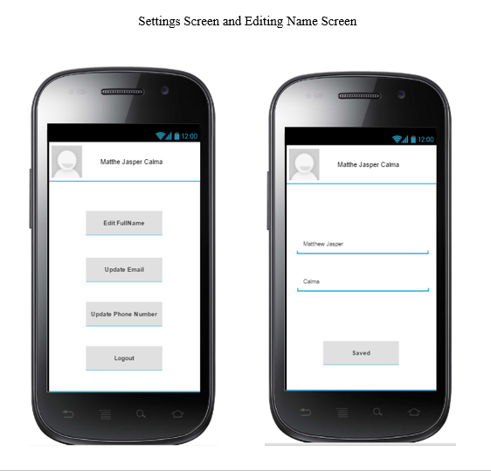
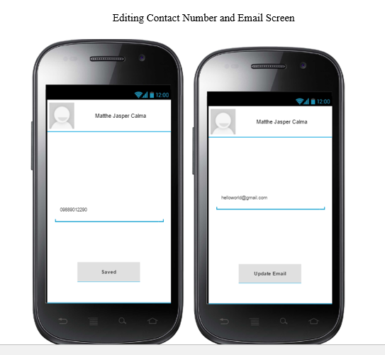

Slide 8
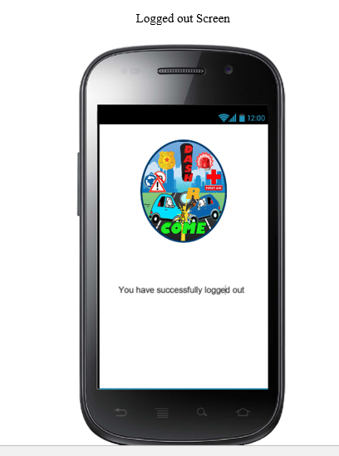

Slide 9
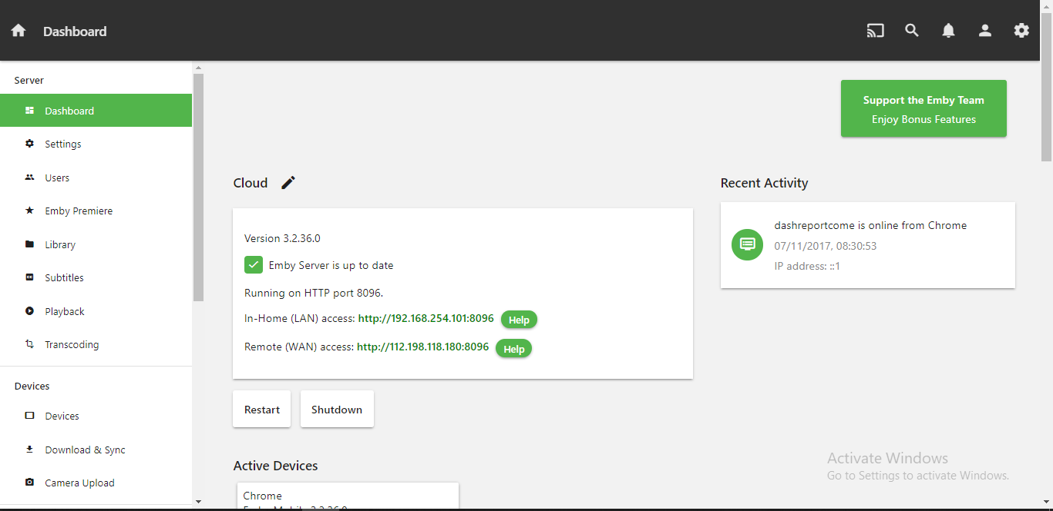
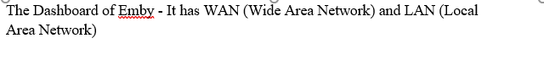

Slide 10
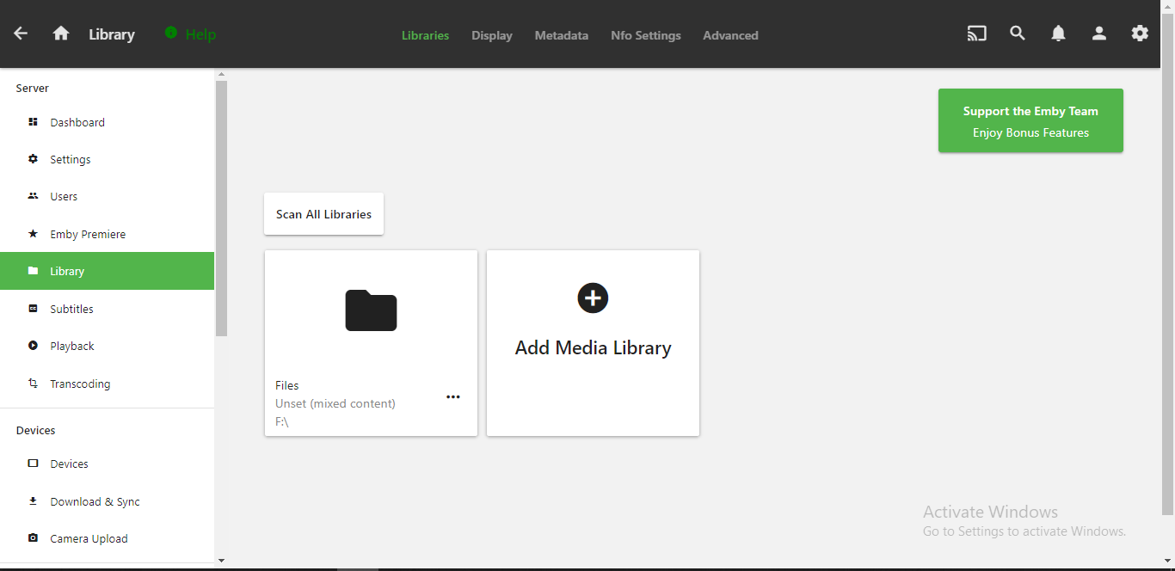
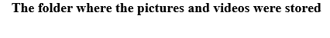

Slide 11
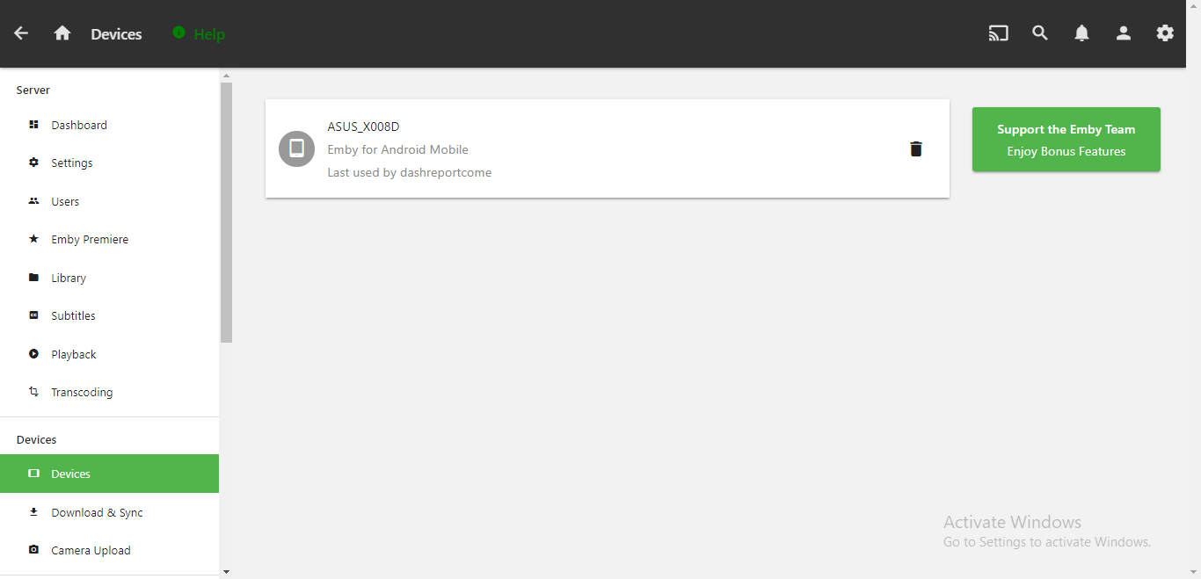

Slide 12
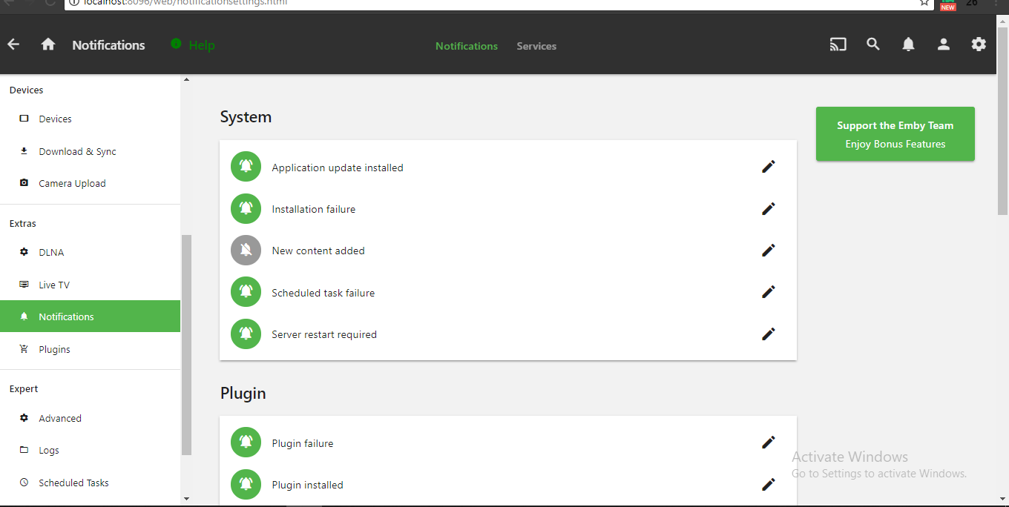

Slide 13
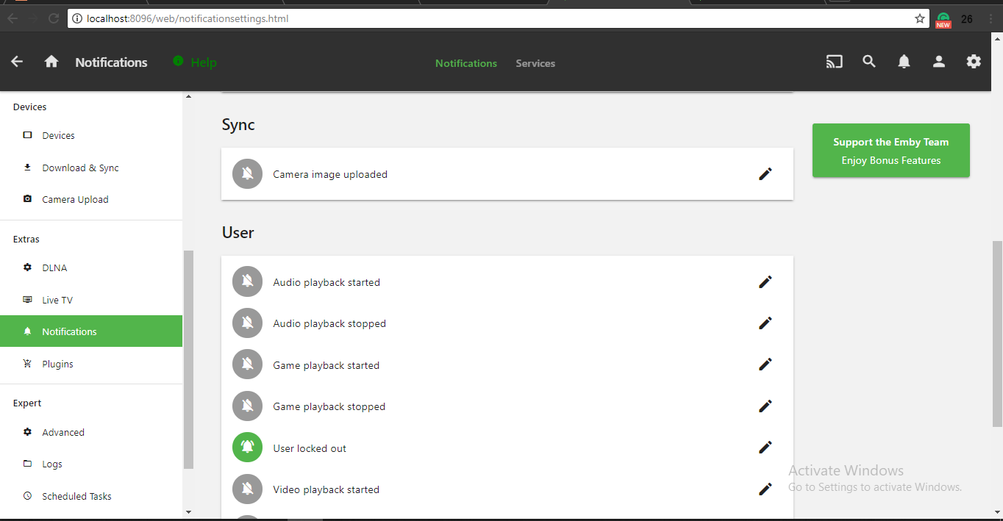

Slide 14
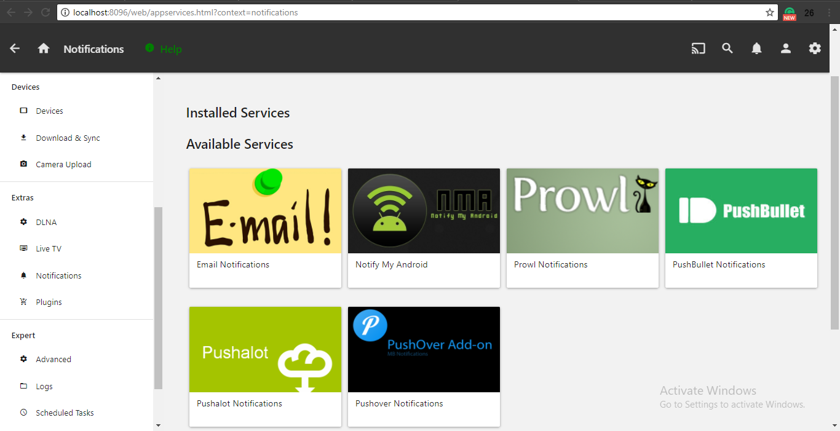

Slide 15
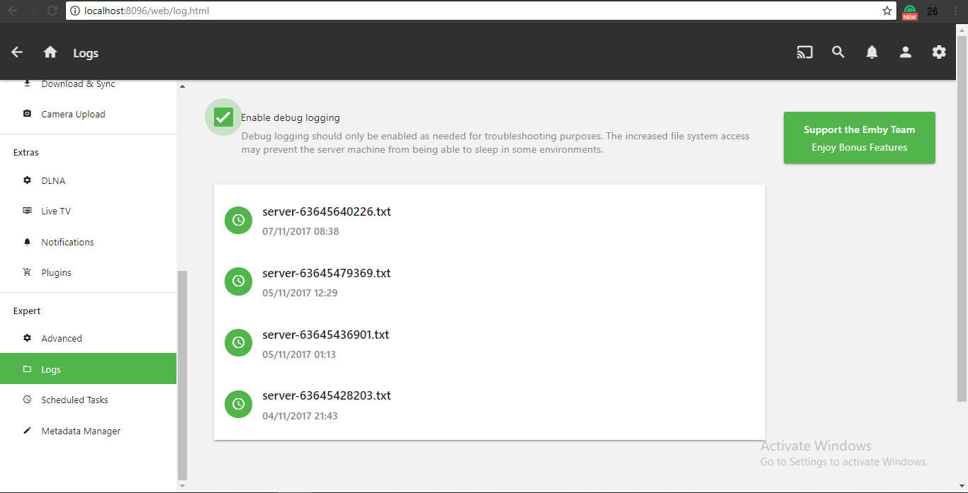
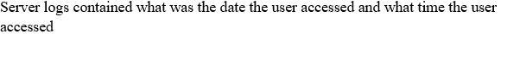

Slide 16
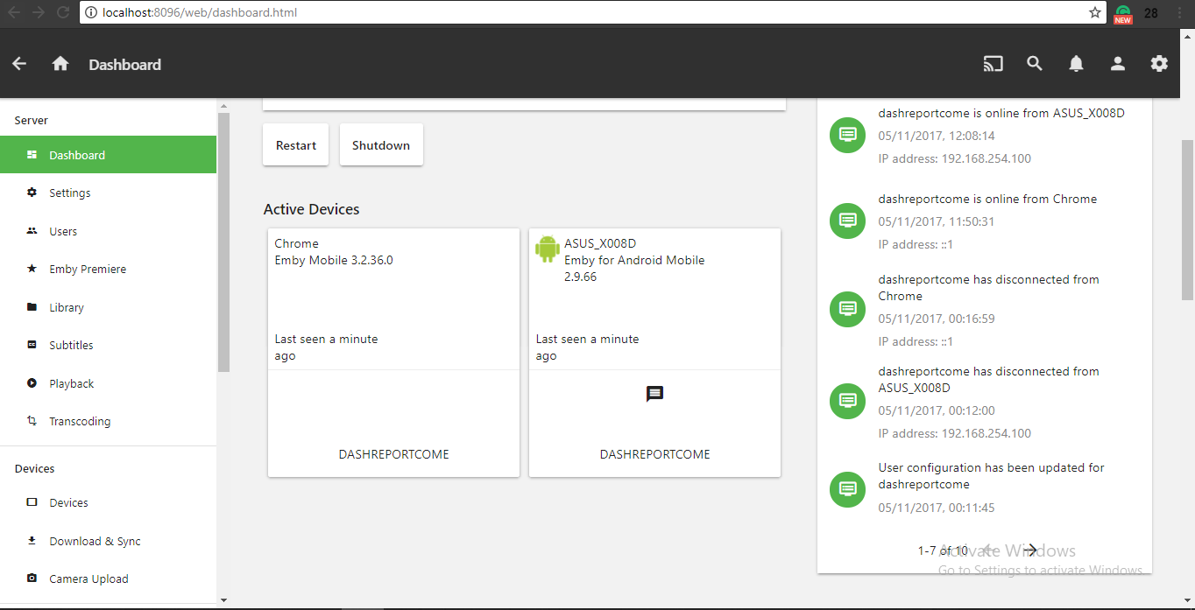


Slide 17
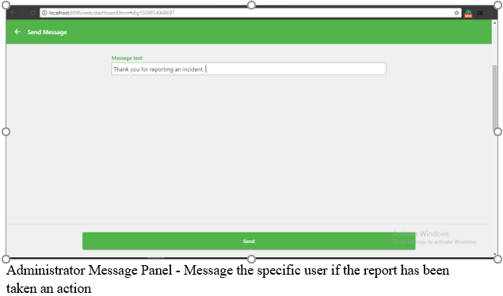
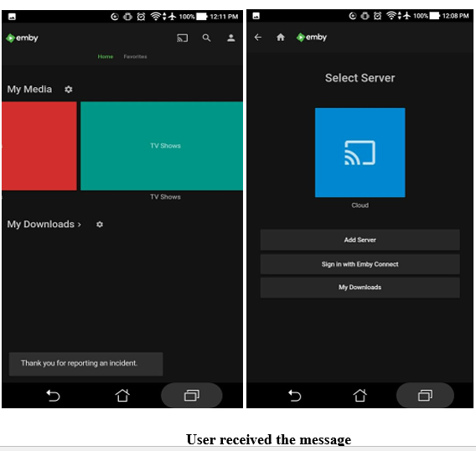

Slide 18
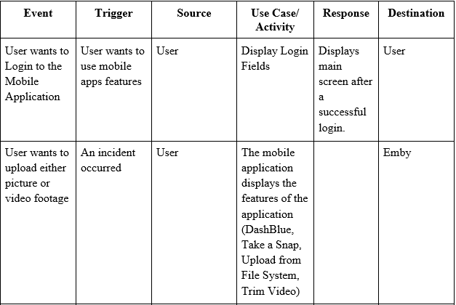
EVENT TABLE

Slide 19
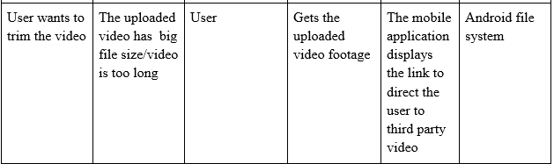
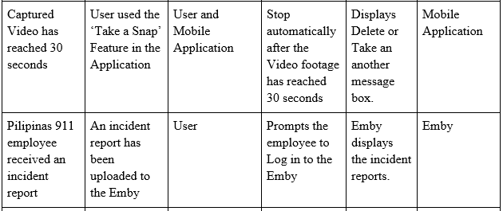

Slide 20
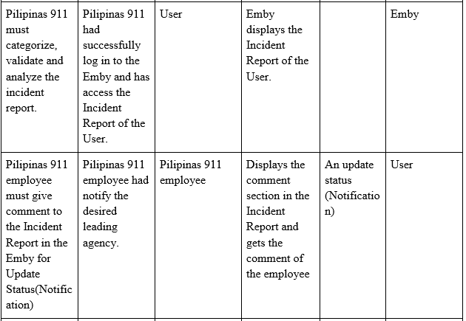

Slide 21
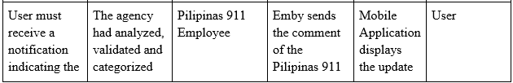
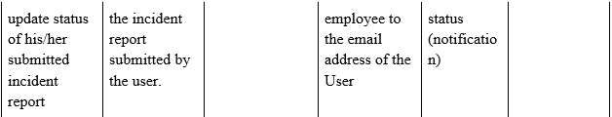

Slide 22
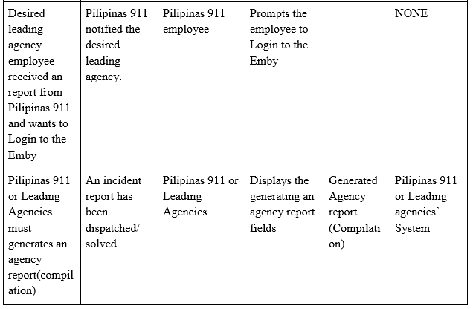

Slide 23
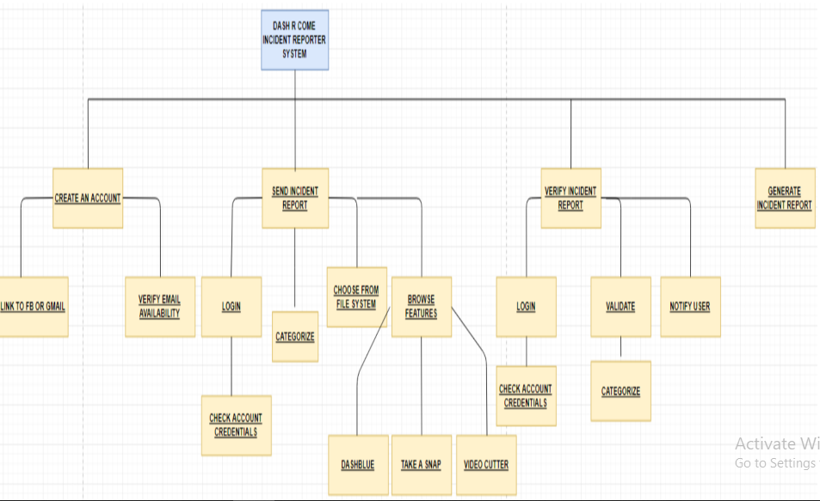
FUNCTIONAL DECOMPOSITION DIAGRAM

Slide 24
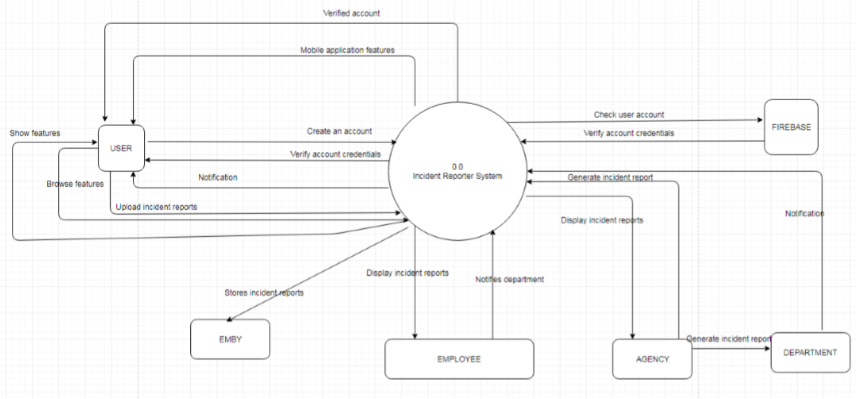
DATA FLOW DIAGRAM: Level 0 Diagram

Slide 25
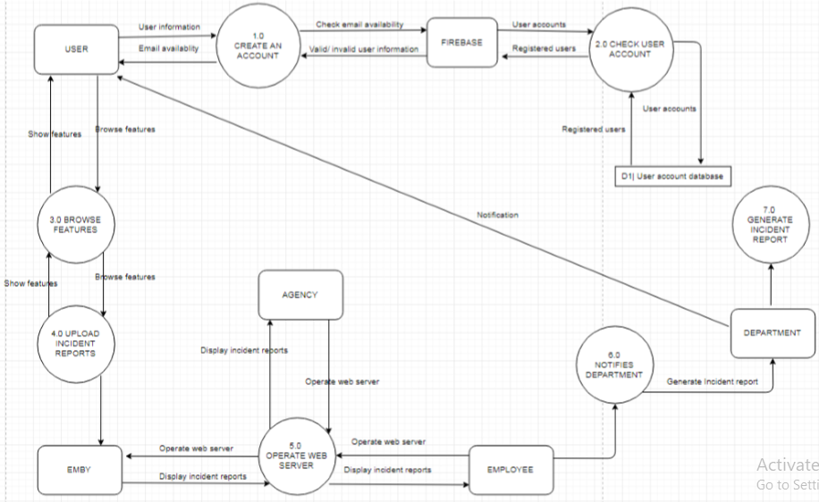
LEVEL 1 DIAGRAM

Slide 26
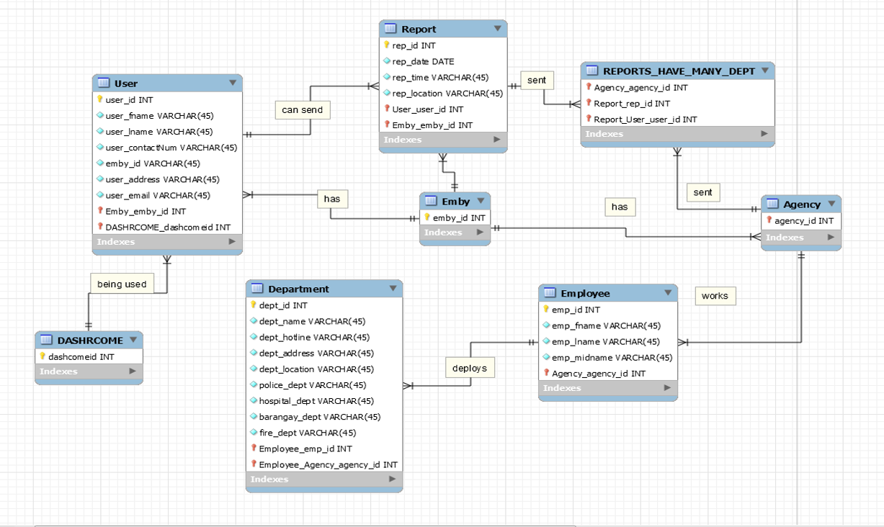
ENTITY RELATIONSHIP DIAGRAM

Slide 27
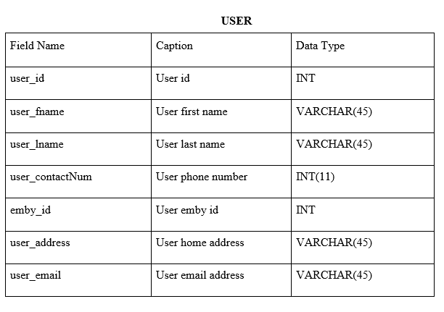
DATA DICTIONARY

Slide 28
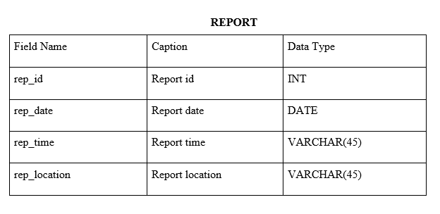
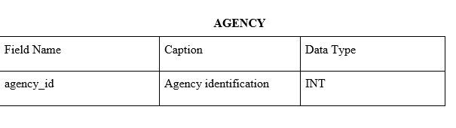
DATA DICTIONARY

Slide 29
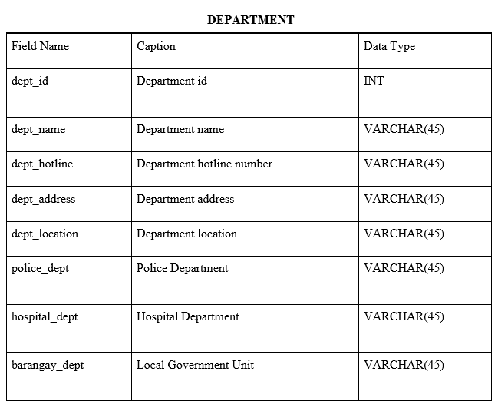
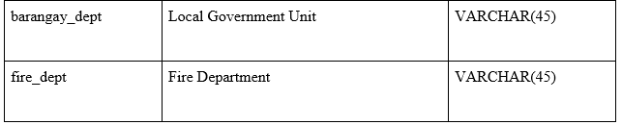
DATA DICTIONARY

Slide 30
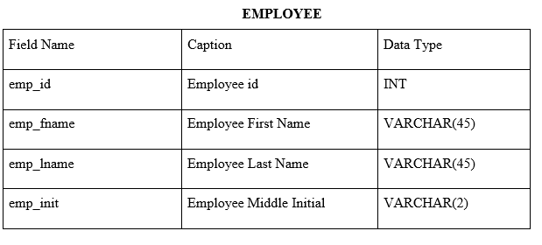
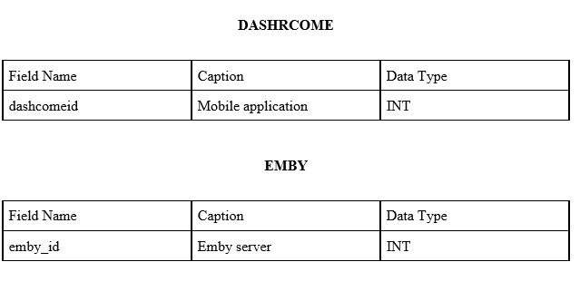
DATA DICTIONARY

Slide 31
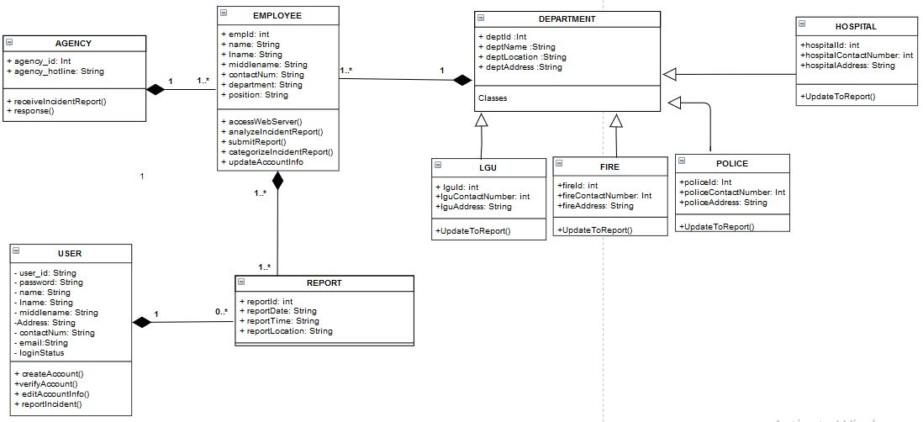
Class Diagram

Slide 32
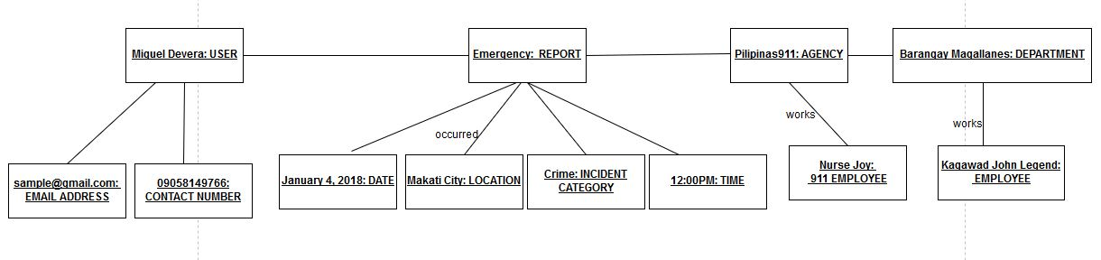
Object Diagram

Slide 33
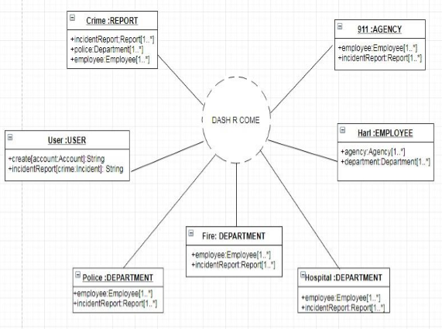
Composite Diagram

Slide 34
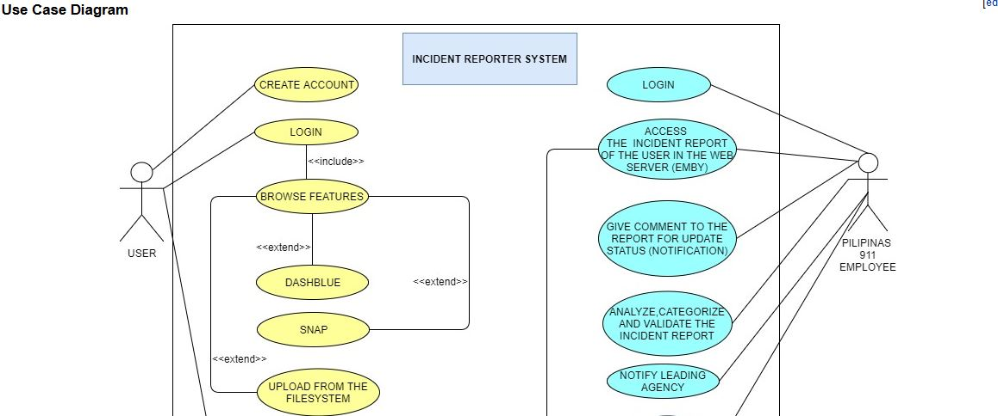
Use Case Diagram

Slide 35
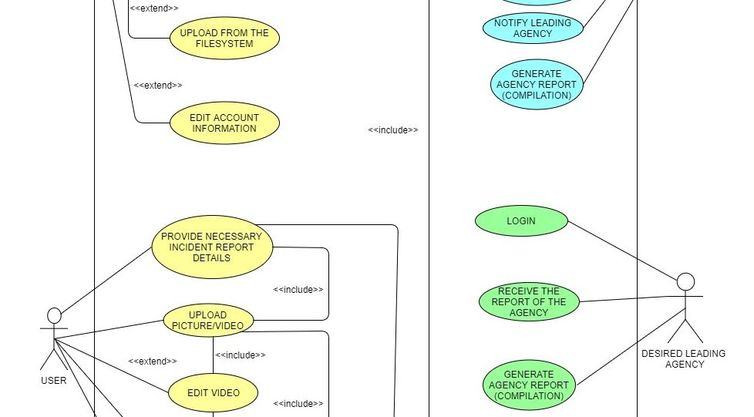
Use Case Diagram

Slide 36
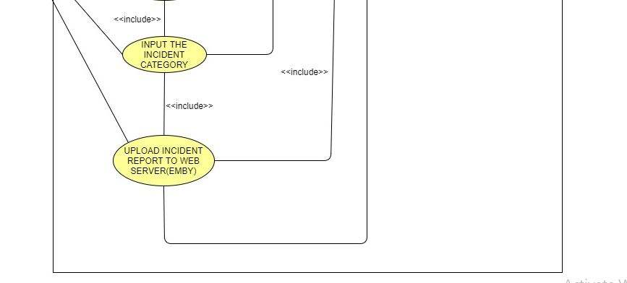
Use Case Diagram

Slide 37
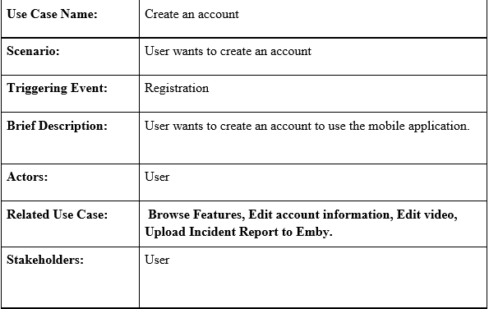
Use Case Full Description

Slide 38
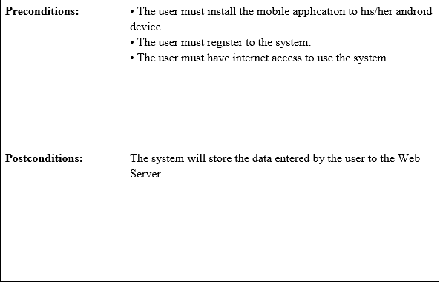
Use Case Full Description

Slide 39
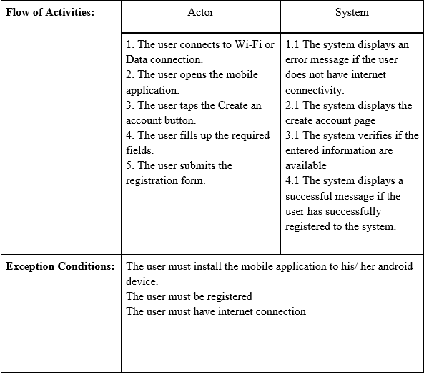
Use Case Full Description

Slide 40
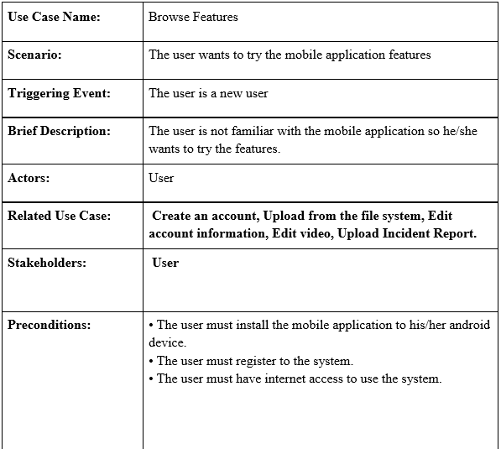
Use Case Full Description

Slide 41
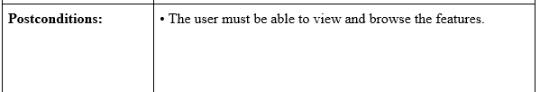

Use Case Full Description

Slide 42

Use Case Full Description

Slide 43

Use Case Full Description

Slide 44


Use Case Full Description

Slide 45


Use Case Full Description

Slide 46

Use Case Full Description

Slide 47


Use Case Full Description

Slide 48

Use Case Full Description

Slide 49

Use Case Full Description

Slide 50

Use Case Full Description

Slide 51

Use Case Full Description

Slide 52


Use Case Full Description

Slide 53

Use Case Full Description

Slide 54


Use Case Full Description

Slide 55

Use Case Full Description

Slide 56


Use Case Full Description

Slide 57

Activity Diagram

Slide 58

Activity Diagram

Slide 59

Sequence Diagram

Slide 60

Sequence Diagram

Slide 61

Sequence Diagram

Slide 62

Sequence Diagram

Slide 63
Deployment Diagram

Slide 64

Deployment Diagram

Slide 65

Deployment Diagram

Slide 66

Deployment Diagram

Slide 67

Communication Diagram

Slide 68

Timing Diagram

Slide 69

Component Diagram

Slide 70

Package Diagram

Slide 71

State Diagram

Slide 72

Interaction Overview Diagram

Slide 73

Interaction Overview Diagram

Slide 74

Interaction Overview Diagram

Slide 75

Interaction Overview Diagram

Slide 76

Interaction Overview Diagram

